Slide 1
Using Data Engines to Read/Write Data

Slide 2
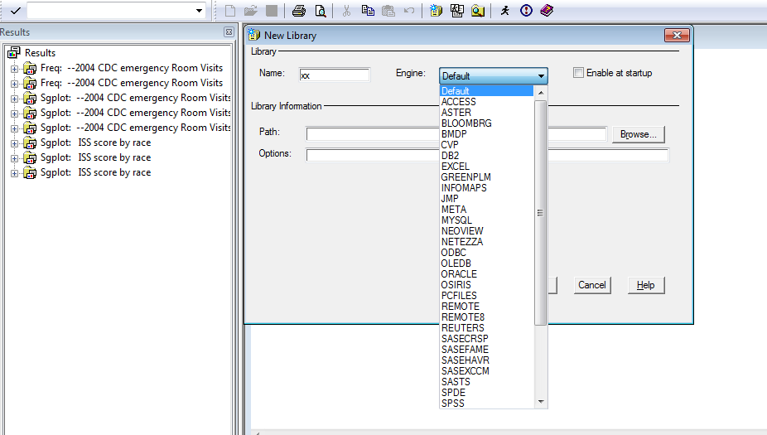
Available Engines

Slide 3
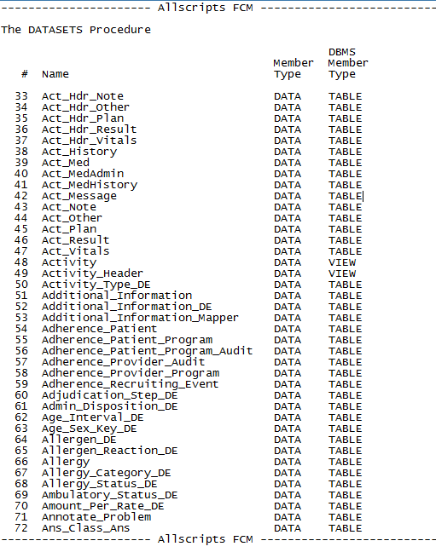
Data files
1361 tables and views

Slide 4
Database files <-> SAS files
SAS | DATA BASE (SQL)
Data set | table
Observation | row
Variable | column
Merge | join
Append | union

Slide 5
Why learn SQL
Proc SQL can not only retrieve information without having to learn SAS syntax, but it can do this very often with fewer and shorter statements than traditional SAS code.
Additionally, SQL uses often fewer resources than conventional DATA and PROC steps. Further the knowledge can be transferred to other SQL packages.

Slide 6
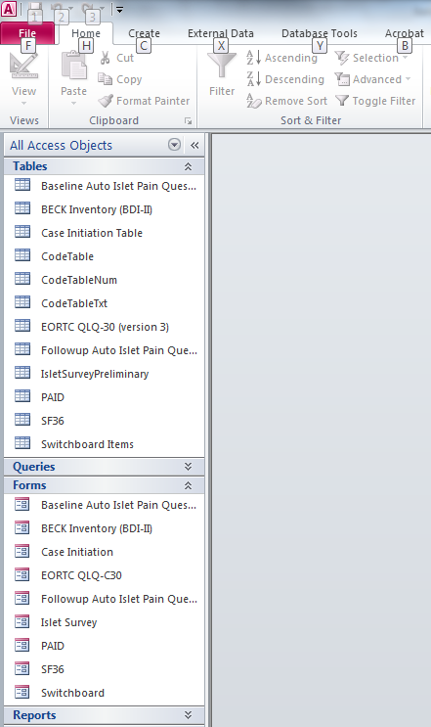

Slide 7
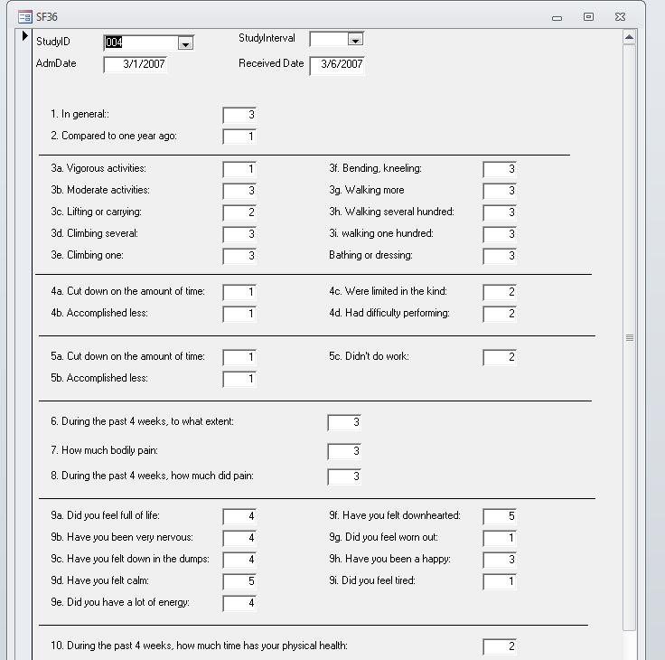

Slide 8
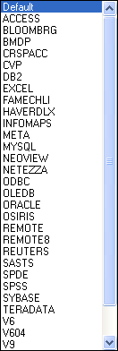
Creating new Libref
Instead of default
Choose
ACCESS
Choosing the library icon
As you are used to do
Or
LIBNAME QoL ‘E:\sas data\QoL_Survey_AG.accdb’;

Slide 9
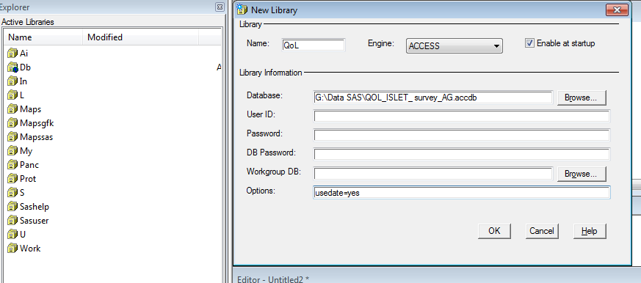
Access data base connection

Slide 10
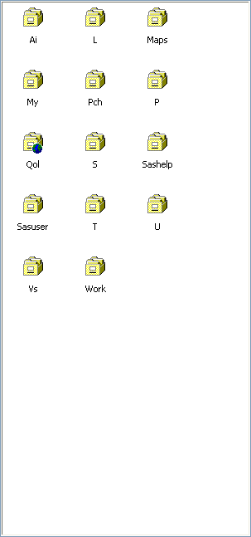
SAS Explorer

Slide 11
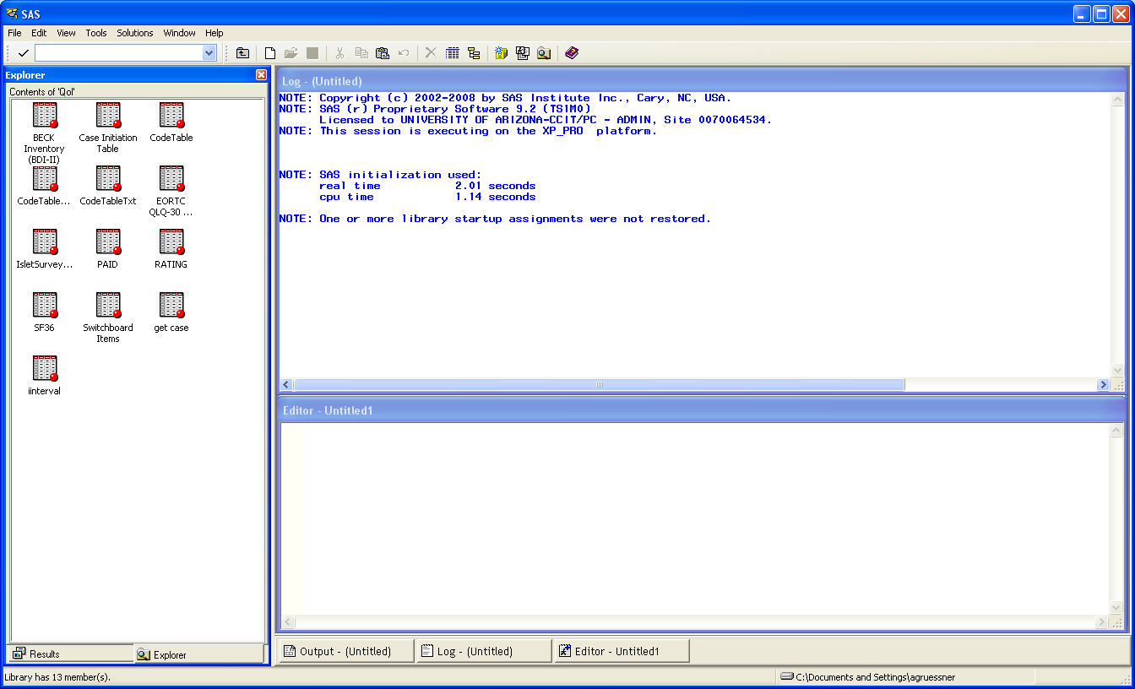

Slide 12
ACCESS Tables
ACCESS tables are data sets which can be changed directly (since SAS9.1)
You can’t directly sort those data sets
You have to open them and copy them in temporary or permanent data sets

Slide 13
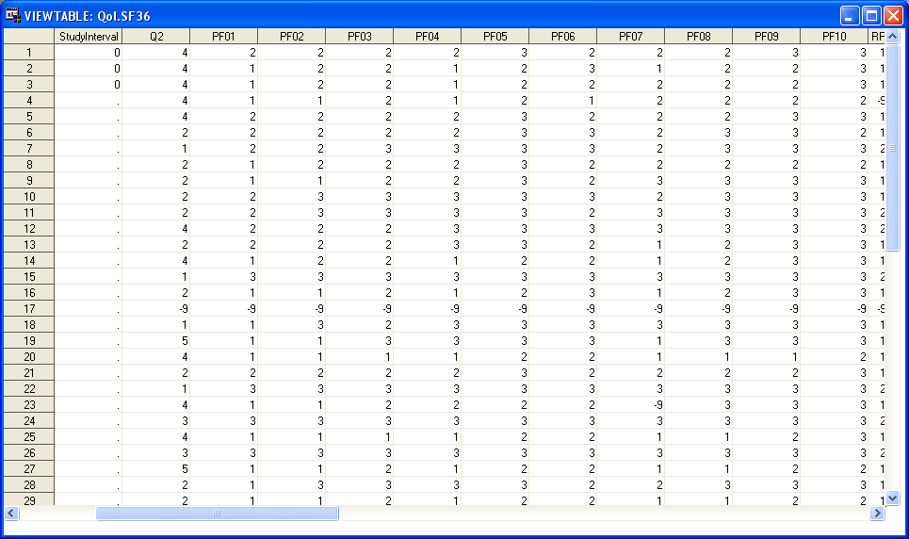
Open the table SF36 in SAS

Slide 14
Access to Tables
proc print data=QoL.sf36;
run;

Slide 15
SQL (Structured Query Language)
SQL is a powerful flexible fourth generation sublanguage that enables complex processing through a few simple statements.
SQL statements allow for the complete creation , maintenance, and reporting of relational database systems using English –like statements.

Slide 16
Proc SQL (Structured Query Language)
PROC SQL;
connect to odbc(
"DSN=Pancreas_db;" ||
"DBQ=C:\Database\BASICMNaccess.mdb;" ||
"DriverId=25;" ||
"FIL=MS Access;" ||
"MaxBufferSize=2048;" ||
"PageTimeout=5;" ||
"UID=admin");
create table WORK.xx as
Select
TX_SURG,
DT_PXTX,
MR_NR,
R_FNAME,
R_LNAME,
R_SSN from connection to odbc(select
A1."TX_SURG",
A1."DT_PXTX",
A1."MR_NR",
A1."R_FNAME",
A1."R_LNAME",
A1."R_SSN"
from "Patients transplanted by Granger" A1
) as t1( TX_SURG, DT_PXTX, MR_NR, R_FNAME, R_LNAME, R_SSN)
;

Slide 17
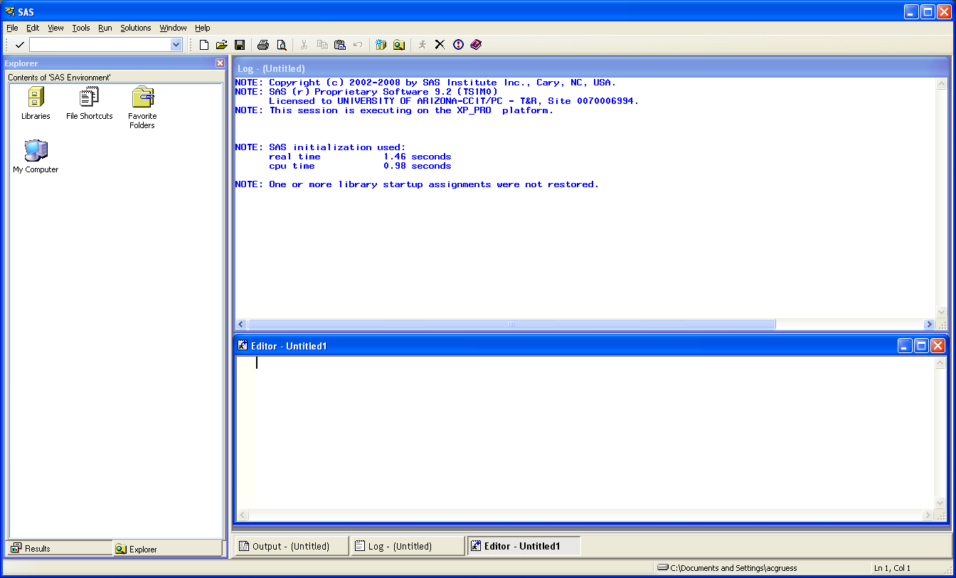
ODBC Open Database Connectivity

Slide 18
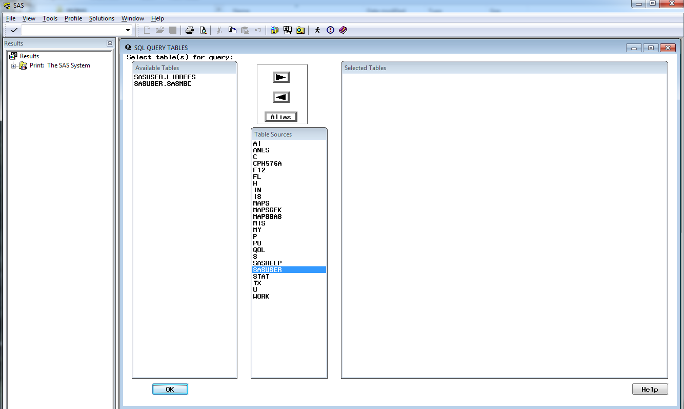

Slide 19
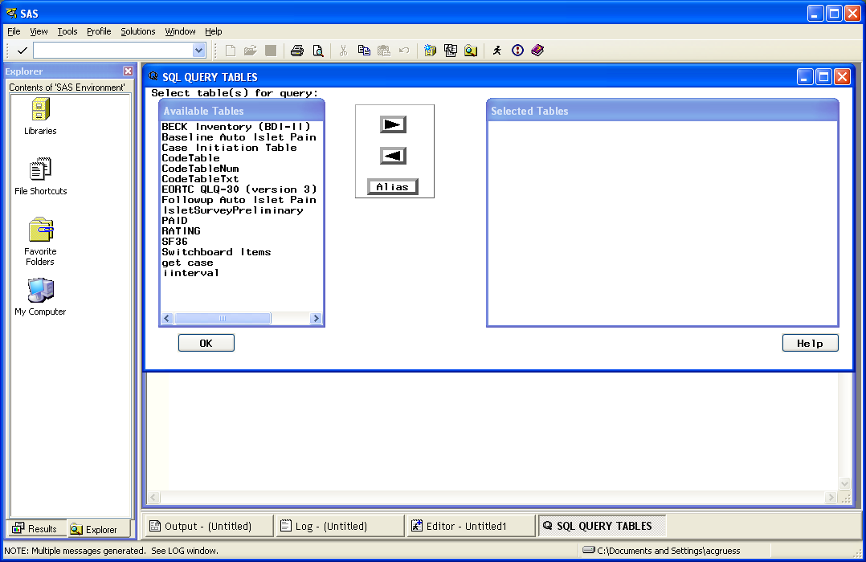

Slide 20
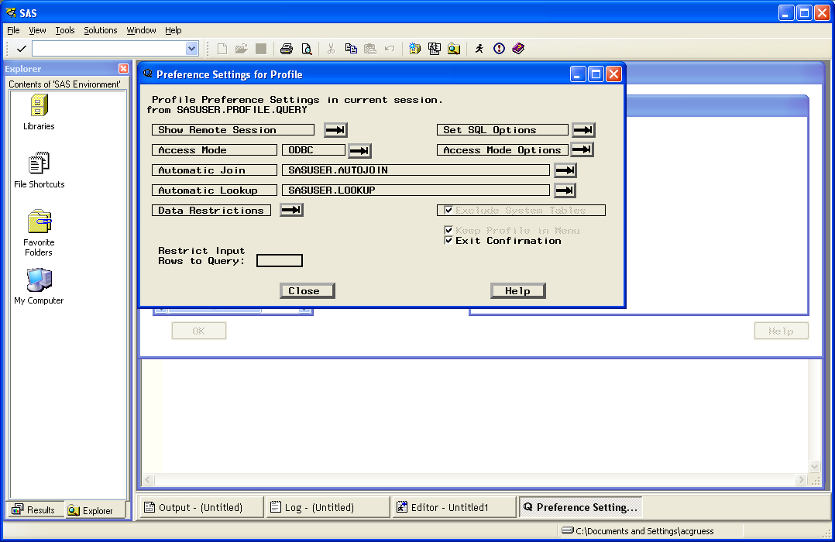

Slide 21
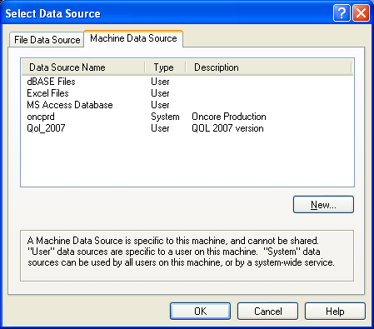
Set Preference

Slide 22
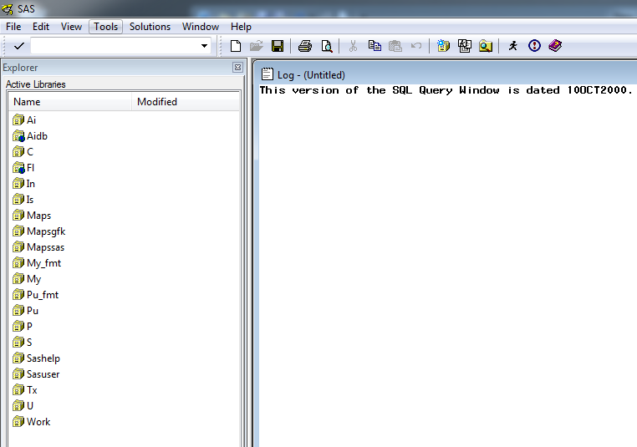
Select Tables for Query

Slide 23
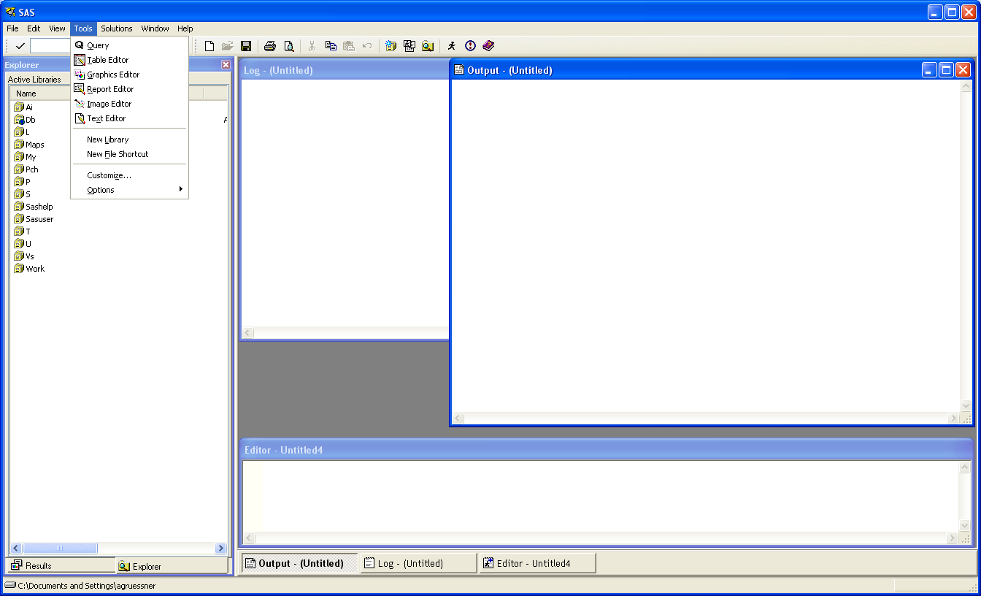

Slide 24
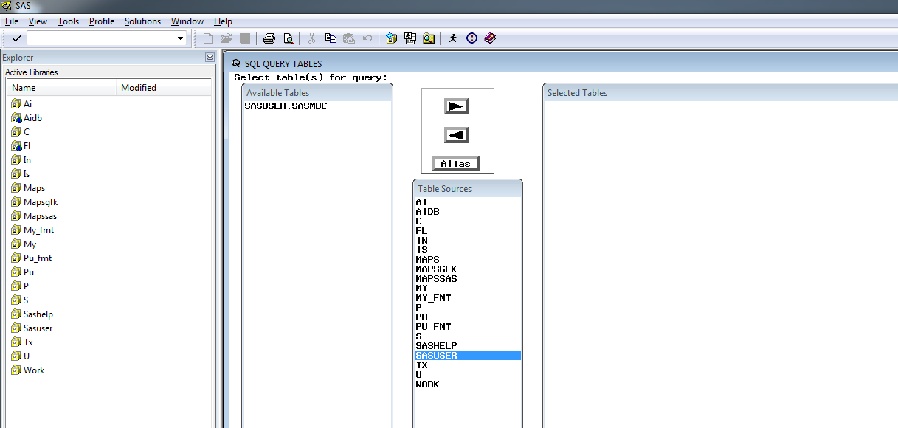

Slide 25
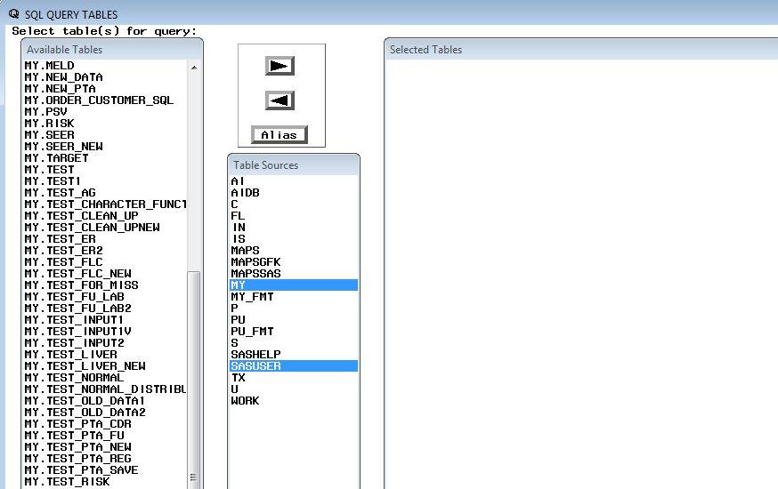
Select Table

Slide 26
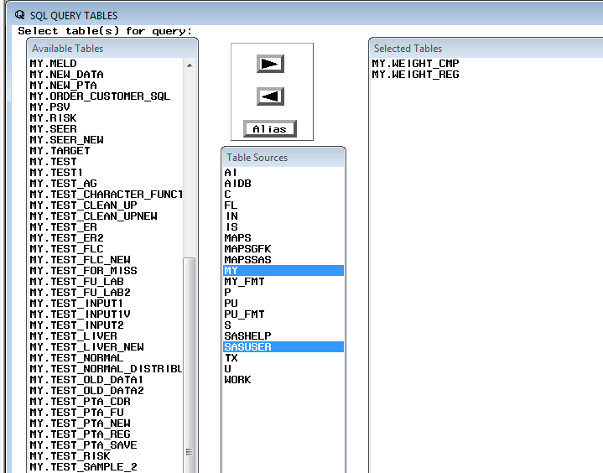
Select 2 Tables

Slide 27
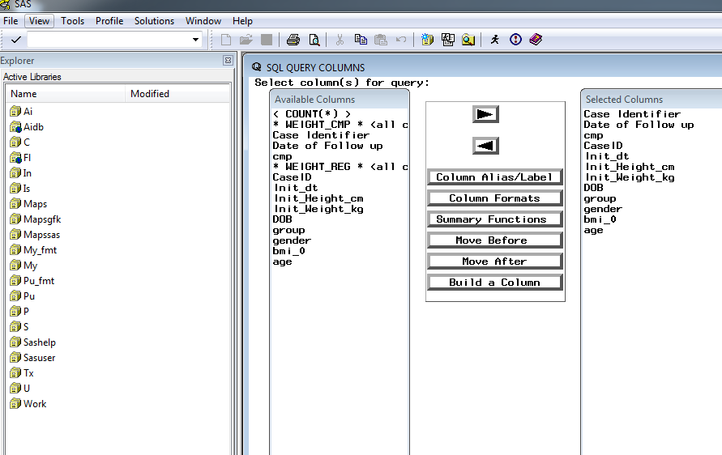
Merge tables (find where)

Slide 28
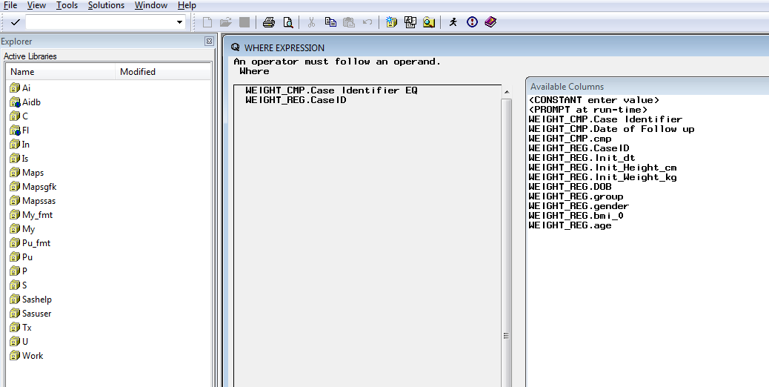

Slide 29
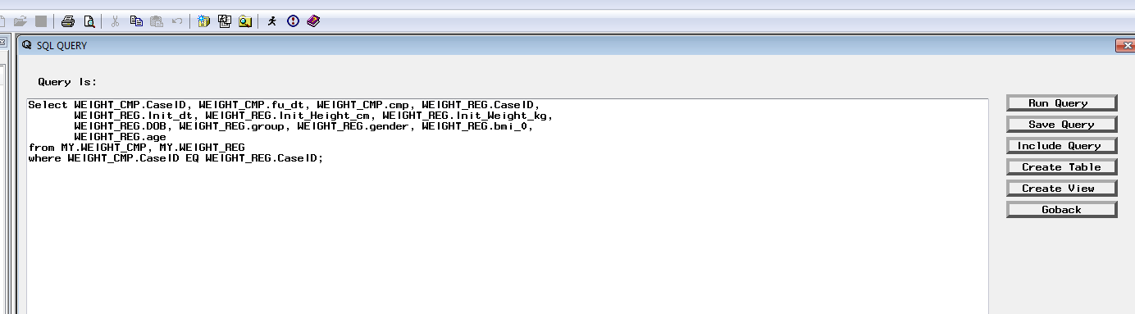
Show Query (TOOLS)

Slide 30
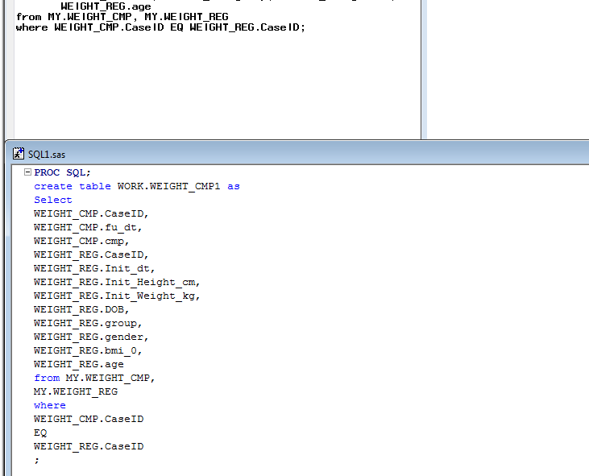
SAVE QUERy
(Save as external file with create table)

Slide 31
PROC SQL
Starts with
PROC SQL;
……………..
and ends with
………………
QUIT;
In between SQL code can be used
Alter
Create
Delete
Drop
Merge
Insert
Select
Update

Slide 32
A table generated in PROC SQL can be referenced in a data step in exactly the same way as a SAS data set. The reverse is also true ; data sets created in a data step can be used in PROC SQL.
PROC SQL allows you to modify and maintain tables in a database system.

Slide 33
As in SAS data sets are all ‘tables’ located in libraries
For example: x.target
Library x

Slide 34
Example 1
Data set : x.Target
ID | Organ | Inst_ID
1024 | K | 1
1079 | P | 1
1158 | K | 4
1024 | K | 1
1396 | K | 1
1257 | H | 4
1079 | L | 5
1079 | K | 5
/* select all kidney transplants */
Proc SQL;
Select ID,
Organ,
Inst_ID
from x.Target
where Organ=‘K’;
Quit;
No output file is created – so the result is send as a listing to the output window!
You need QUIT to remove SQL from the memory

Slide 35
Example 2a
Data set : x.Target
ID | Organ | Inst_ID
1024 | K | 1
1079 | P | 1
1158 | K | 4
1024 | K | 1
1396 | K | 1
1257 | H | 4
1079 | L | 5
1079 | K | 5
/* select all variables in kidney transplants */
Proc SQL;
Select *
from x.Target
where Organ=‘K’;
Quit;

Slide 36
Example 2b
Data set : x.Target
ID | Organ | Inst_ID
1024 | K | 1
1079 | P | 1
1158 | K | 4
1024 | K | 1
1396 | K | 1
1257 | H | 4
1079 | L | 5
1079 | K | 5
/* select all kidney transplants
and create new data set */
Proc SQL;
Create table KidneyTx as
Select *
from x.Target
where organ=‘K’;
Quit;

Slide 37
Example 2c
Data set : x.Target
ID | Organ | Inst_ID
1024 | K | 1
1079 | P | 1
1158 | K | 4
1024 | K | 1
1396 | K | 1
1257 | H | 4
1079 | L | 5
1079 | K | 5
/* select all kidney transplants
and create new data set of distinct patients */
Proc SQL;
Create table KidneyTx as
Select distinct ID, Organ, Inst_ID
from x.Target
where organ=‘K’;
Quit;

Slide 38
Example 2d
Data set : x.Target
ID | Organ | Inst_ID
1024 | K | 1
1079 | P | 1
1158 | K | 4
1024 | K | 1
1396 | K | 1
1257 | H | 4
1079 | L | 5
1079 | K | 5
/* select all kidney transplants
and create new data set of ordered distinct patients */
Proc SQL;
Create table KidneyTx as
Select distinct ID, Organ, Inst_ID
from x.Target
order by ID
where Organ=‘K’;
Quit;

Slide 39
Example 3 (Simple Merge / Join)
ID | Organ | Inst_ID
1024 | K | 1
1158 | K | 4
1079 | L | 5
Inst_ID | country | Cont
1 | USA | NrAm
4 | G | Eu
5 | G | Eu
/* Merge 2 data sets */
Proc SQL;
Select ID,
Organ,
Target.Inst_ID,
Country,
Cont
from x.Target,
x.Inst_Lookup
;
Quit;
Only subject which are in both tables will be listed

Slide 40
Example 4
x.Target
x.Inst_lookup
ID | Organ | Inst_ID
1024 | K | 1
1158 | K | 4
1079 | L | 5
Inst_ID | country | Cont
1 | USA | NrAm
4 | G | Eu
5 | G | Eu
/* Merge 2 data sets */
Proc SQL;
Select ID,
Organ,
Target.Inst_ID,
Country,
Cont
from x.Target,
x.Inst_Lookup
where Target.Inst_ID eq Inst_Lookup.Inst_ID;
Quit;
Only subject which are in both tables will be listed

Slide 41
Example 5
ID | Organ | Inst_ID
1024 | K | 1
1158 | K | 4
1079 | L | 5
Inst_ID | country | Cont
1 | USA | NrAm
4 | G | Eu
5 | G | Eu
/* Merge 2 data sets */
Proc SQL;
Select ID ,
organ,
T.inst_ID as T_ID,
L.inst_ID as L_ID,
country,
cont
from x.Target as T,
x.Inst_Lookup as L
where T_ID eq L_ID ;
Quit;
Example for use of Alias

Slide 42
Example 5 (Inner Join)
ID | Organ | Inst_ID
1024 | K | 1
1158 | K | 4
1079 | L | 5
Inst_ID | country | Cont
1 | USA | NrAm
4 | G | Eu
5 | G | Eu
/* Merge 2 data sets */
Proc SQL;
Select ID,
organ,
T.inst_Id as Target_inst_ID,
L.inst_ID as Lkup_inst_ID,
country,
cont
from x.Target as T inner join
x.Inst_Lookup as L
on Target_inst_ID eq Lkup_inst_ID ;
Quit;

Slide 43
Merge SAS data files and DB Tables
Proc SQL;
Create Table merge_SAS_db
select *
from x.Target as x left join my.reg as y
On x.ID = y.PatID;
Quit;

Slide 44
What is the difference?
Proc SQL;
Select ID,
organ,
T.inst_Id as Target_inst_ID,
L.inst_ID as Lkup_inst_ID,
country,
name,
cont
from x.Target as T left join
x.Inst_Lookup as L
on T.inst_ID eq L.inst_ID ;
Quit;
Proc sort data= x.Target;
By Inst_ID;
Run;
Proc sort data= x.Inst_Lookup;
By Inst_ID;
Run;
Data x.Target;
Merge x.Target (in=inTarget) x.Inst_Lookup;
By Inst_id;
If inTarget;
Run;
Proc freq;
Table country;
Run;

Slide 45
x.Target
x.Surgeon
PatID | Organ | SurgID
1024 | K | S1
1079 | P | S8
1158 | K | S4
1024 | K | S1
1396 | K | S1
1257 | H | S4
1079 | L | S5
1079 | K | S9
SurgID | SurgName | Hospital
S1 | Dr. X1 | UMC
S2 | Dr. X2 | UMC
S3 | Dr. X3 | UMC
S4 | Dr. X4 | TMC
S5 | Dr. X5 | VA
=> Left Join
PatID | Organ | SurgID | SurgName | Hospital
1024 | K | S1 | Dr. X1 | UMC
1079 | P | S8
1158 | K | S4 | Dr. X4 | TMC
1024 | K | S1 | Dr. X1 | UMC
1396 | K | S1 | Dr. X1 | UMC
1257 | H | S4 | Dr. X4 | TMC
1079 | L | S5 | Dr. X5 | VA
1079 | K | S9

Slide 46
Example 5 (Left Join)
/* Merge 2 data sets */
Proc SQL;
Select
PatID,
Organ,
T.SurgId as Target_SurgID,
L.SurgID as Lkup_SurgID,
SurgName,
Hospital
from x.Target as T left join
x.Surgeon as L
on Target_SurgID eq Lkup_SurgID
;
Quit;

Slide 47
PatID | Organ | SurgID
1024 | K | S1
1079 | P | S8
1158 | K | S4
1024 | K | S1
1396 | K | S1
1257 | H | S4
1079 | L | S5
1079 | K | S9
SurgID | SurgName | Hospital
S1 | Dr. X1 | UMC
S2 | Dr. X2 | UMC
S3 | Dr. X3 | UMC
S4 | Dr. X4 | TMC
S5 | Dr. X5 | VA
=> Inner Join
PatID | Organ | SurgID | SurgName | Hospital
1024 | K | S1 | Dr. X1 | UMC
1158 | K | S4 | Dr. X4 | TMC
1024 | K | S1 | Dr. X1 | UMC
1396 | K | S1 | Dr. X1 | UMC
1257 | H | S4 | Dr. X4 | TMC
1079 | L | S5 | Dr. X5 | VA

Slide 48
Example 5 (Inner Join)
/* Merge 2 data sets */
Proc SQL;
Select
PatID,
Organ,
T.SurgId as Target_SurgID,
L.SurgID as Lkup_SurgID,
SurgName,
Hospital
from x.Target as T inner join
x.Surgeon as L
on Target_SurgID eq Lkup_SurgID
;
Quit;

Slide 49
PatID | Organ | SurgID
1024 | K | S1
1079 | P | S8
1158 | K | S4
1024 | K | S1
1396 | K | S1
1257 | H | S4
1079 | L | S5
1079 | K | S9
SurgID | SurgName | Hospital
S1 | Dr. X1 | UMC
S2 | Dr. X2 | UMC
S3 | Dr. X3 | UMC
S4 | Dr. X4 | TMC
S5 | Dr. X5 | VA
=> Full Join
PatID | Organ | SurgID | SurgName | Hospital
1024 | K | S1 | Dr. X1 | UMC
1079 | P | S8
. | . | S2 | Dr. X2 | UMC
. | . | S3 | Dr. X3 | UMC
1158 | K | S4 | Dr. X4 | TMC
1024 | K | S1 | Dr. X1 | UMC
1396 | K | S1 | Dr. X1 | UMC
1257 | H | S4 | Dr. X4 | TMC
1079 | L | S5 | Dr. X5 | VA
1079 | K | S9

Slide 50
Example 5 (Full Join)
/* Merge 2 data sets */
Proc SQL;
Select
PatID,
Organ,
T.SurgId as Target_SurgID,
L.SurgID as Lkup_SurgID,
SurgName,
Hospital
from x.Target as T full join
x.Surgeon as L
on Target_SurgID eq Lkup_SurgID
;
Quit;

Slide 51
PatID | Organ | SurgID
1024 | K | S1
1079 | P | S8
1158 | K | S4
1024 | K | S1
1396 | K | S1
1257 | H | S4
1079 | L | S5
1079 | K | S9
SurgID | SurgName | Hospital
S1 | Dr. X1 | UMC
S2 | Dr. X2 | UMC
S3 | Dr. X3 | UMC
S4 | Dr. X4 | TMC
S5 | Dr. X5 | VA
=> Right Join
PatID | Organ | SurgID | SurgName | Hospital
1024 | K | S1 | Dr. X1 | UMC
. | . | S2 | Dr. X2 | UMC
. | . | S3 | Dr. X3 | UMC
1158 | K | S4 | Dr. X4 | TMC
1024 | K | S1 | Dr. X1 | UMC
1396 | K | S1 | Dr. X1 | UMC
1257 | H | S4 | Dr. X4 | TMC
1079 | L | S5 | Dr. X5 | VA

Slide 52
Example 5 (right Join)
/* Merge 2 data sets */
Proc SQL;
Select
PatID,
Organ,
T.SurgId as Target_SurgID,
L.SurgID as Lkup_SurgID,
SurgName,
Hospital
from x.Target as T right join
x.Surgeon as L
on Target_SurgID eq Lkup_SurgID
;
Quit;

Slide 53
SELECT STATEMENT
PROC SQL
SELECT <Distinct> *|<table|alias.> column|expression…..>
<INTO clause>
FROM <libref.>table <alias> <JOIN operator> <libref.>table <alias>
< ON clause>
< WHERE clause>
< GROUP BY clause>
< HAVING clause>
< ORDER BY clause>
< USING clause>
;

Slide 54
Demo_SAS.mdb
Customers
Employees
Key : CustomerID
Key : EmployeeID
Orders
Invoice
Key : OrderID
Key : InvoiceID

Slide 55
Employees
Employee ID | Hired Date | Salary | Department | Job Code | Last Name | First Name
119012 | 7/1/1983 | $42,340.58 | CSR010 | 602 | WOLF-PROVENZA | G.
120591 | 12/5/1995 | $31,000.55 | SHP002 | 602 | HAMMERSTEIN | S.
127845 | 1/16/1983 | $75,320.34 | ACC024 | 204 | MEDER | VLADIMIR
129540 | 8/1/1997 | $56,123.34 | SHP002 | 204 | CHOULAI | CLARA
Customers
Customer ID | State | Zip Code | Country | Phone | Name | Address | City
14324742 | CA | 95123 | USA | 408/629-0589 | SANTA CLARA VALLEY | 5089 CALERO AVENUE | SAN JOSE
14569877 | NC | 27514 | USA | 919/489-6792 | PRECISION PRODUCTS | 198 FAYETTEVILLE ROAD | MEMPHIS
14898029 | MD | 20850 | USA | 301/760-2541 | UNIVERSITY BIOMEDICAL MATERIALS | 1598 PICCARD DRIVE | ROCKVILLE

Slide 56
Orders
Order ID | Stock ID | Fabric Charges | Shipped To | Ordered Date | Shipped Date | Taken By | Processed By
11269 | 9870 | $11,063,836.00 | 19876078 | 10/3/2004 |  | 212916
11270 | 1279 | $2,256,870.00 | 39045213 | 10/3/2004 | 10/19/2004 | 321783 | 237642
Invoice
Invoice ID | Billed To | Country | Amount Billed in US Dollars | Billed By | Billed On | Paid On
11270 | 39045213 | Brazil | $3,675,848,666.21 | 239185 | 10/5/2004 | 10/18/2004
11271 | 18543489 | USA | $11,063,836.00 | 457232 | 10/5/2004

Slide 57
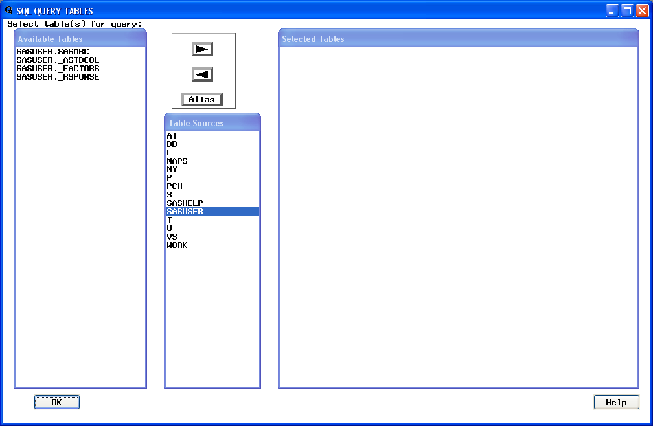

Slide 58
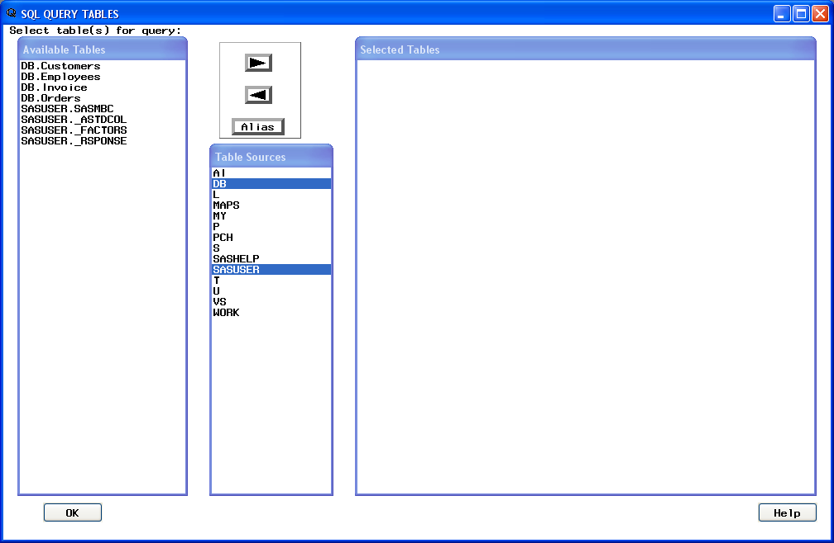

Slide 59
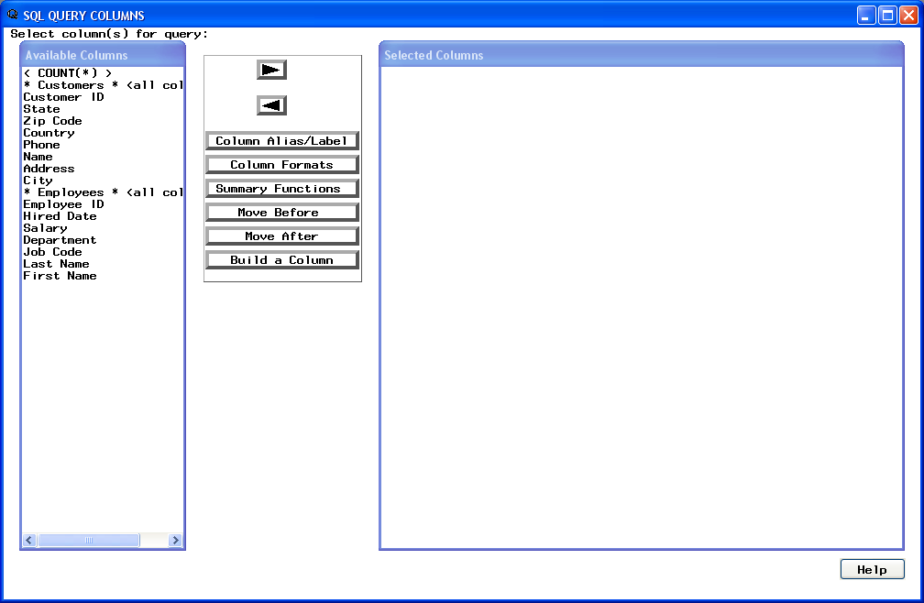

Slide 60
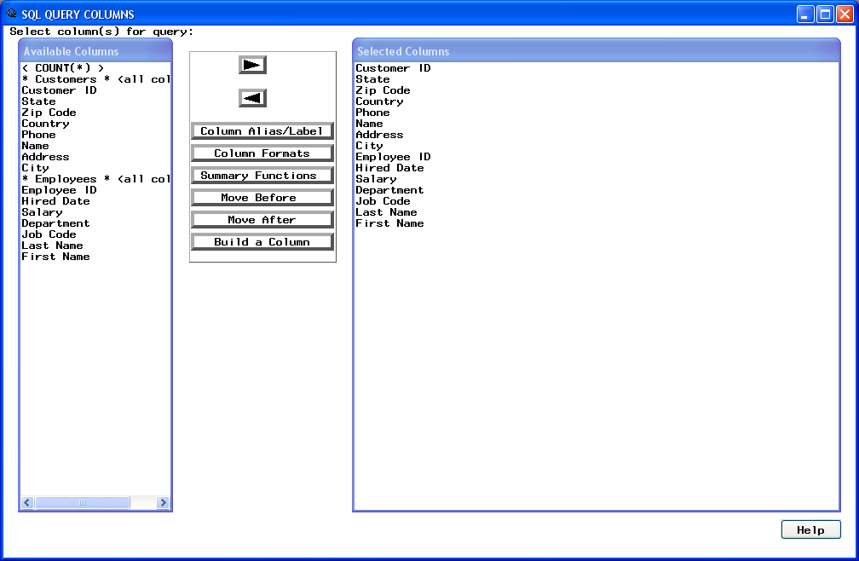

Slide 61
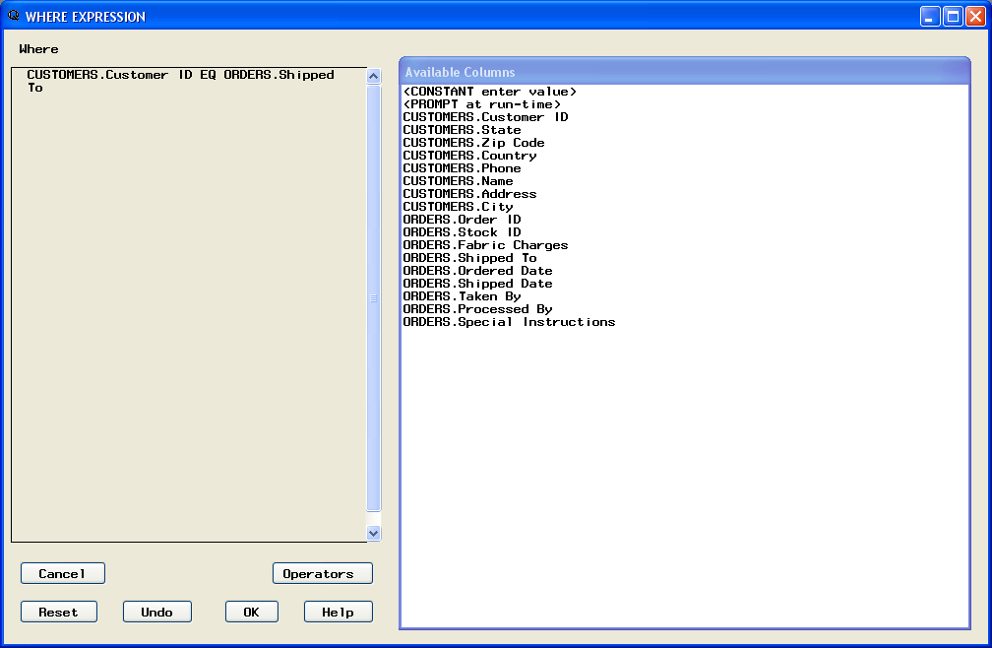
Choose under the View Tab

Slide 62
